Slide 1
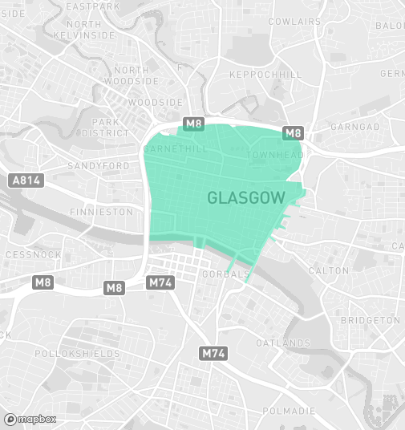

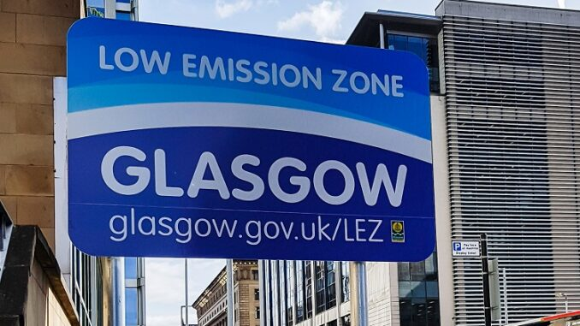
Air pollution remains a serious issue in many urban areas, particularly due to traffic emissions. Our research question is:
Has the introduction of the Low Emission Zone (LEZ) in Glasgow significantly reduced NO₂ and PM2.5 levels?
This question is important because these pollutants can seriously affect public health. Air pollution has been shown to cause cancers, with research showing that for every 10 μg/m3 of increased exposure to fine particulate matter (PM2.5), the risk of dying from any cancer rose by 22% (Asthma + Lung UK, Scotland).
Air pollution is estimated to cost the Scottish economy over £1.1 billion each year in days lost at work and costs to the NHS.
By analyzing air quality before and after the LEZ was introduced, we aim to assess how effective this policy has been and whether it could serve as a model for other cities in Scotland.

Slide 2
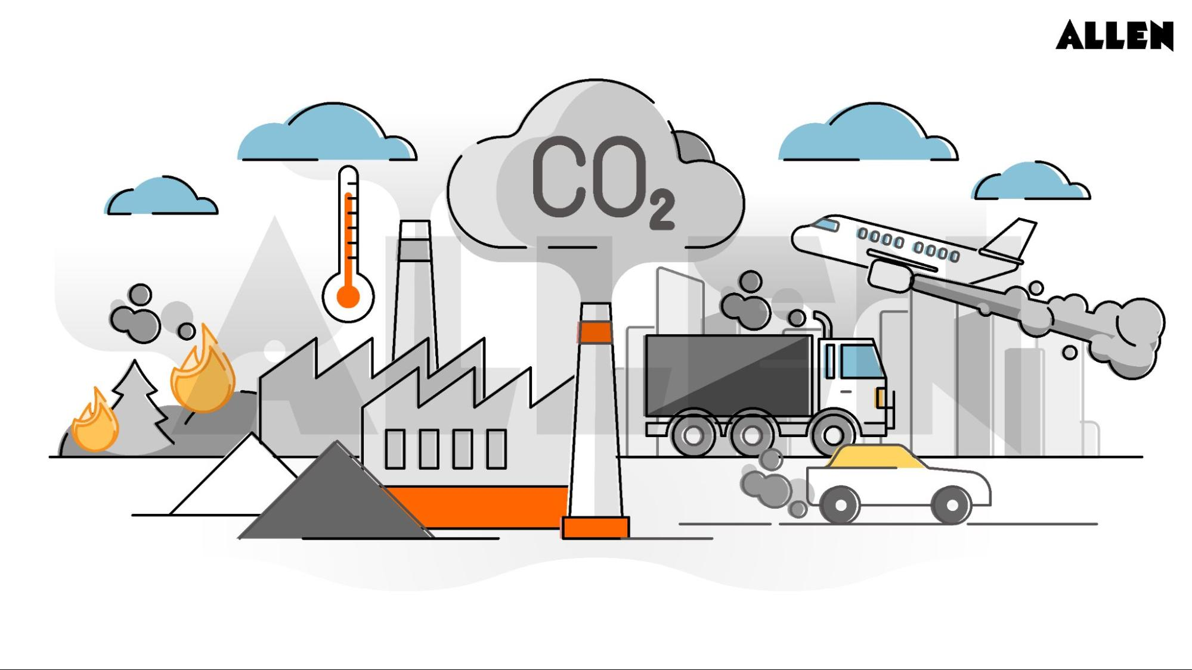
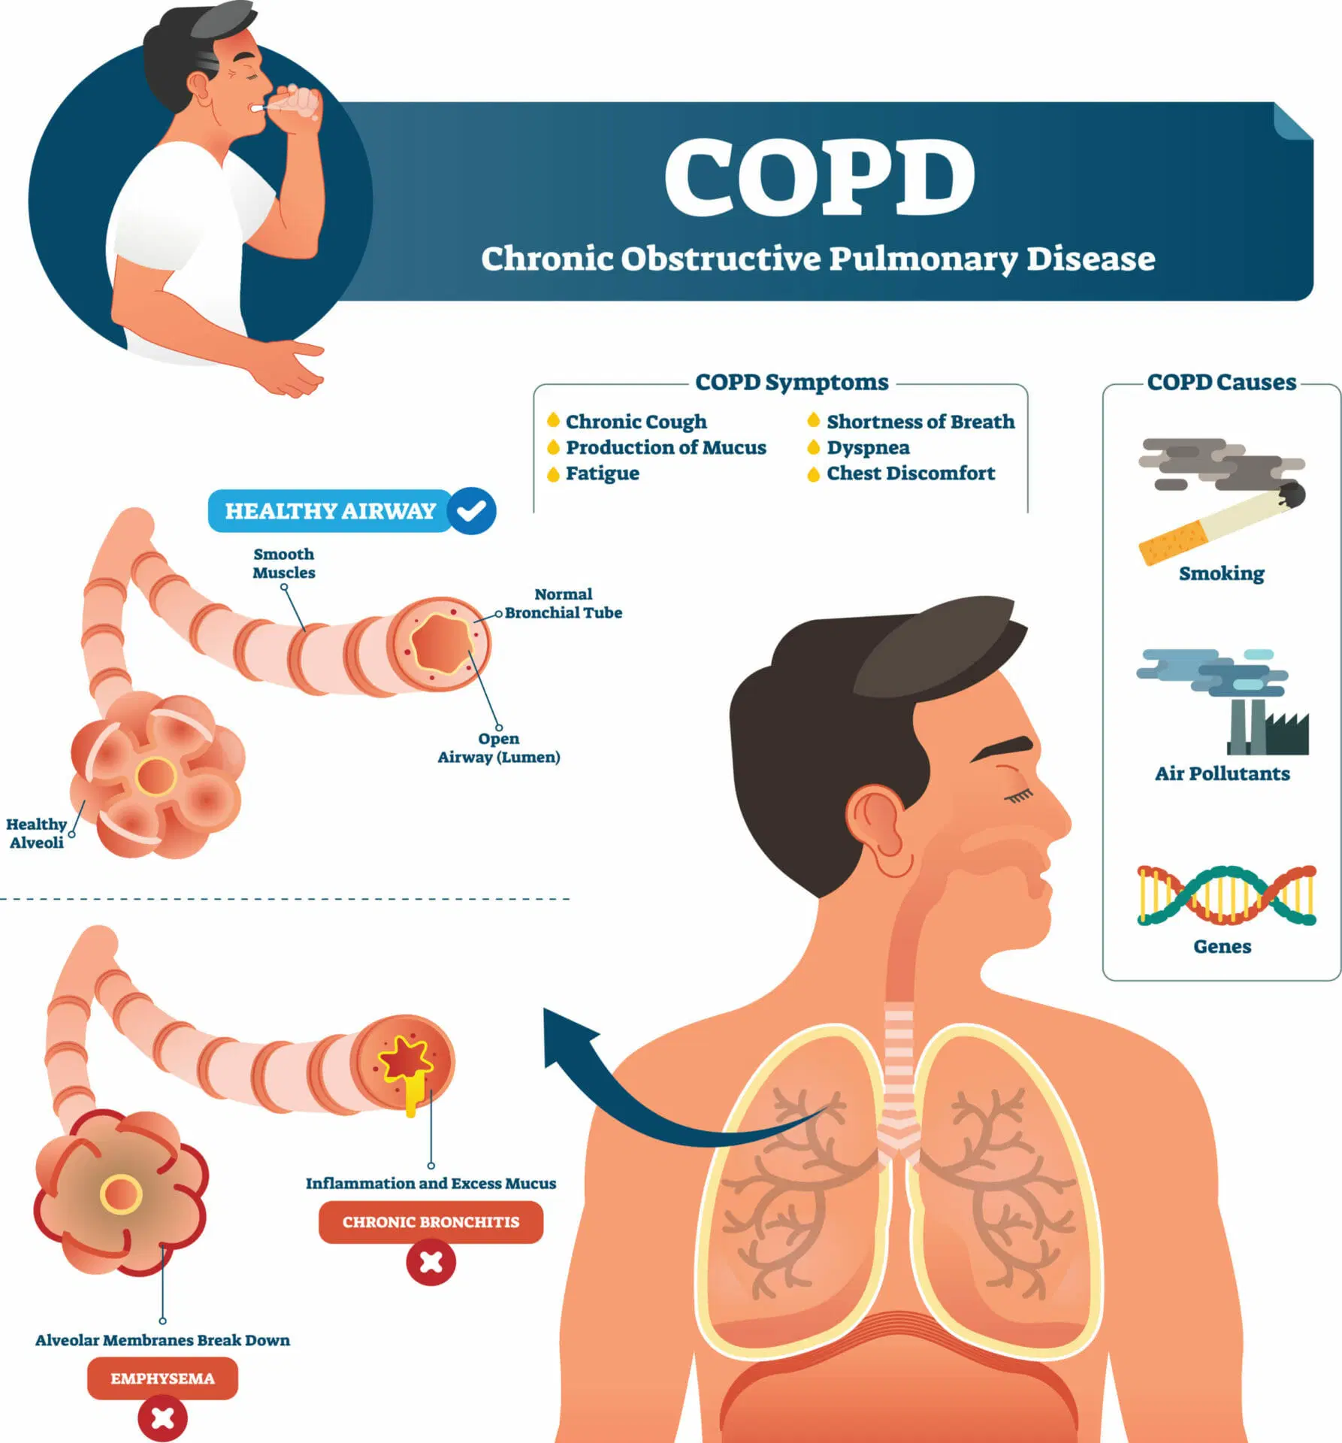
Air pollutants:
NO₂ – Nitrogen Dioxide: Produced mainly by vehicle exhaust and industrial emissions Health impacts: Irritates lungs and airways Worsens asthma and bronchitis Increases risk of lung infections and heart disease
PM2.5 – Fine Particulate Matter (≤ 2.5µm): Comes from vehicle emissions, burning fuels, and industrial processes Health impacts: Enters deep into lungs and bloodstream Linked to heart attacks, strokes, lung cancer Can stunt children’s lung development
PM10 – Coarse Particulate Matter (≤ 10µm): Includes dust, pollen, mould, and smoke Health impacts: Irritates eyes, nose, and throat Can trigger asthma and worsen Chronic Obstructive Pulmonary Disease (COPD)

Slide 3

🎯 Project Aim:
To evaluate the effectiveness of Glasgow’s Low Emission Zone (LEZ) in reducing air pollution, specifically NO₂ and PM2.5 levels.
Project Objectives:
Analyse NO₂ and PM2.5 levels before and after the LEZ implementation
Identify trends and patterns using data visualisation
Evaluate whether the LEZ has led to a statistically significant improvement in air quality

Slide 4
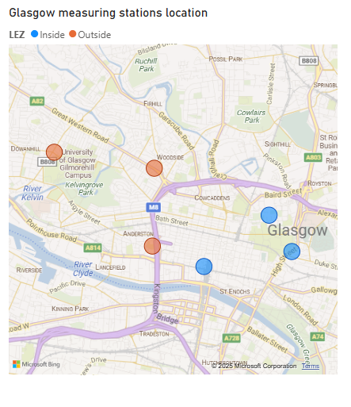
Dataset Overview:
The data was sourced from DEFRA’s UK Air Data Archive, and is produced by Automatic Network monitoring stations. These produce hourly pollutant concentrations. Some belong to the national monitoring strategy, and some are locally managed.
The time range covered was the 5 most recent full years, 1/1/2020 to 31/12/2024
The chosen data was from 6 roadside monitoring stations in Glasgow: The 3 inside the LEZ: Townhead, High Street, Kerbside (at Glasgow Central Railway Station) The 3 closest stations outside the LEZ: Anderston, Byres Road, Great Western Road
Cleaning removed metadata, extra units columns and changed the measured numbers to the correct data type. The measurement columns were given new names for readability and to include units of measurement.
Variables:
Datetime - made from the Date and Time columns, records every hour
NO₂, (µg/m³) - Nitrogen Dioxide
PM2.5 (µg/m³) - PM2.5 Particulate Matter (hourly measured)
PM10 (µg/m³) - PM10 Particulate Matter (hourly measured)
Byres Rd
Great Western Rd
Townhead
Anderston
Kerbside
High St

Slide 5
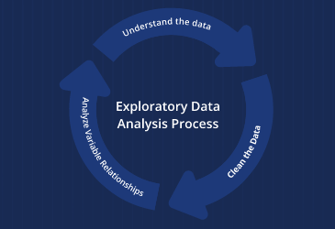
Exploratory Data Analysis (EDA):
Initial summary:
We performed summary statistics and visualised distributions for each site
We checked for null values and calculated the percentage of them to see how we can deal with them
We also checked for any duplicate values
Initial trends:
Reduction in NO₂ Levels Inside LEZ: Clear decrease in average NO₂ concentrations at monitoring stations within the LEZ (e.g., Townhead, High Street, Kerbside) Suggests the LEZ has had a direct and positive impact on traffic-related air pollution.
PM2.5 Levels Dropped Slightly Inside LEZ: PM2.5 levels reduced after LEZ, though the change is less dramatic than NO₂ Still shows early signs of improvement likely linked to reduced vehicle emissions.
PM10 Reduction Is Modest or Minimal: PM10 levels showed a small drop in some locations, but not consistent across all sites PM10 may be influenced by other sources (e.g., construction, dust) beyond vehicle emissions.
Outside LEZ, Pollution Levels Stayed Steady: NO₂, PM2.5, and PM10 levels at sites outside the LEZ (e.g., Anderston, Byres Road, Dumbarton Road) showed little or no change This confirms the LEZ impact is localised to the targeted area.
Data is Right-Skewed Across All Stations: All pollutant distributions are right-skewed, meaning most days have low pollution, with a few extreme spikes Median is a better measure than mean for central values in this dataset.

Slide 6
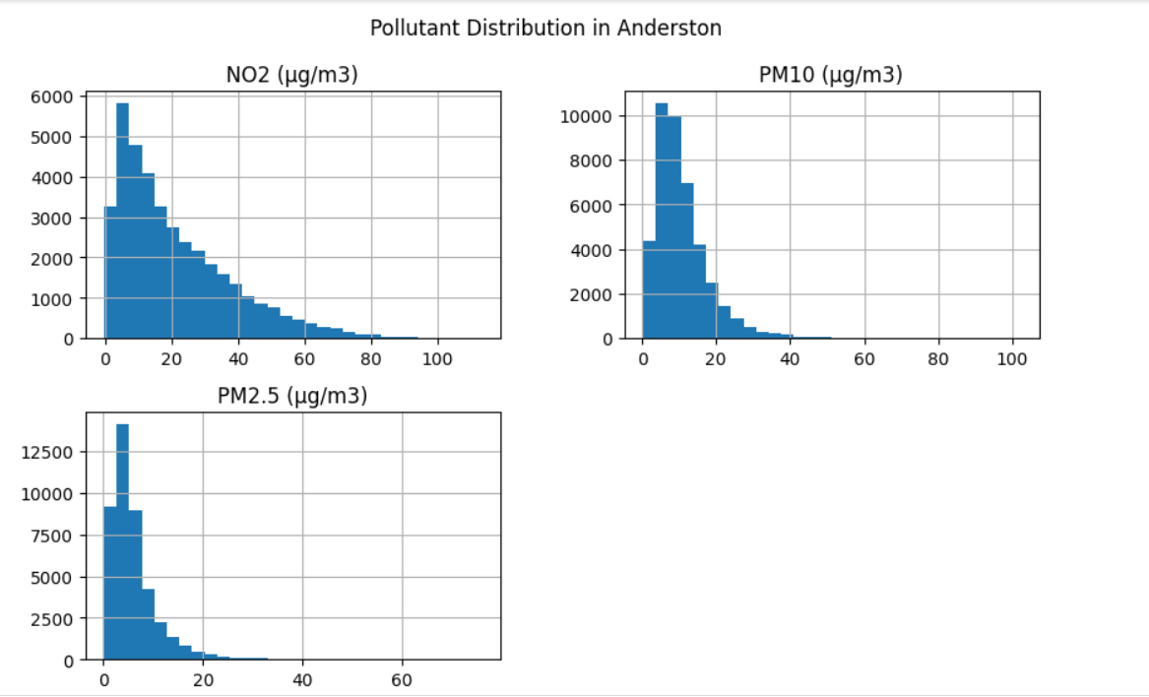
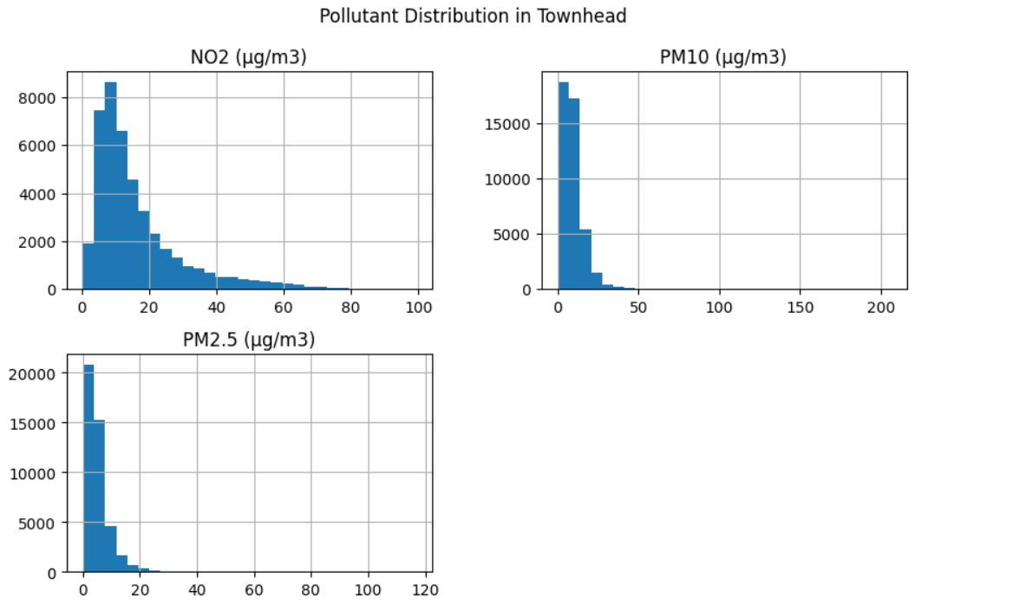
Data Distribution:
Key Insight: Right-Skewed Distribution
The distributions of NO₂, PM2.5, and PM10 are right-skewed (positively skewed)
Most values are concentrated at the lower end, with occasional high spikes
These spikes may occur during traffic congestion, poor weather, or industrial events
Why This Is Important:
This pattern is typical in air quality data
It shows that high pollution levels are less frequent, but still significant
Since the data is not normally distributed, the median may better represent typical values than the mean
It also suggests that non-parametric statistical methods may be more appropriate

Slide 7
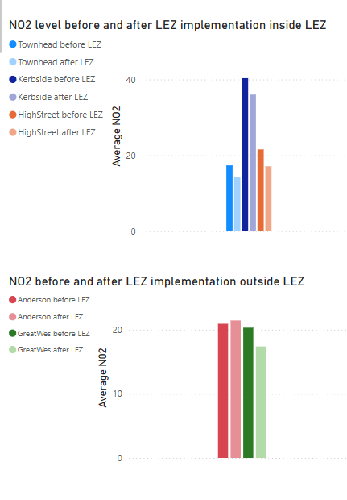
Before vs After LEZ on NO₂ levels:
🧪Method: We compared average NO₂ and PM2.5 levels before and after the introduction of Glasgow’s Low Emission Zone (LEZ)
The LEZ officially came into effect in June 2023, so we used: Before LEZ: Jan 2019 – May 2023 After LEZ: June 2023 – December 2024
Top graph: All three locations show a clear decrease in NO₂ after the LEZ was introduced in June 2023
Townhead: Big drop
Kerbside: Still the highest overall, but reduced
High Street: Also a noticeable decrease
-> LEZ had a positive impact on reducing NO₂ levels at stations inside the restricted zone
Bottom graph: NO₂ levels are roughly the same before and after the LEZ
Anderston: levels increased post LEZ - could be due to location as it’s next to a big city road
Minor reduction, but not as significant as the inside-LEZ stations
Areas outside the LEZ did not experience a major drop in NO₂ levels, showing that the LEZ’s effect was localised to its coverage area.
These graphs clearly shows that the biggest improvements in NO₂ levels happened in areas inside the Low Emission Zone.
Outside the LEZ, pollution levels remained fairly steady.
This supports the idea that the LEZ had a direct and localised impact on reducing air pollution.

Slide 8
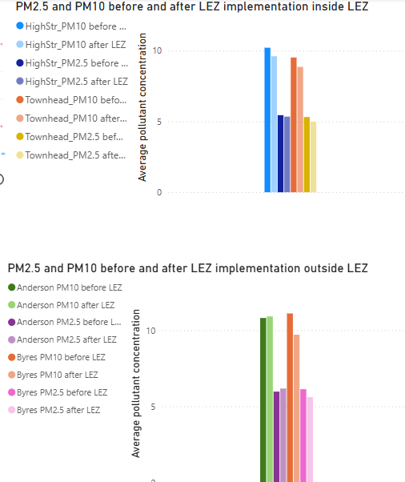
Before vs After LEZ on PM2.5 and PM10 levels:
Top graph: PM10: Slight decrease after LEZ in both locations PM2.5: More noticeable drop, especially at Townhead
After LEZ, both PM2.5 and PM10 levels decreased
with PM2.5 showing a stronger reduction
(likely because PM2.5 is more directly affected by traffic emissions.)
Bottom graph: PM2.5 and PM10 levels remained almost the same before and after Very slight changes, but not significant
Outside the LEZ, pollution levels stayed mostly constant,
showing that the LEZ's impact was limited to areas it directly covers.
These graphs shows that PM2.5 and PM10 levels dropped more clearly in areas inside the LEZ
while levels outside the LEZ stayed relatively unchanged.
This supports the view that LEZ policies can improve air quality,
but the effect is strongest in directly targeted areas.

Slide 9
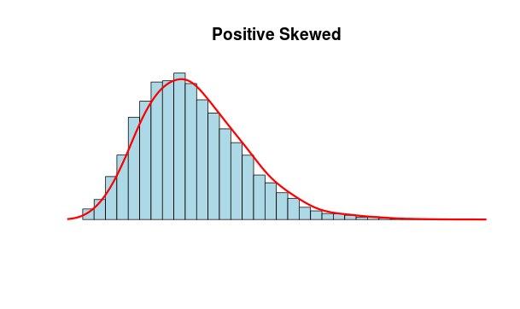
Key Findings – Distribution & Correlation Insights
Pollutant Distributions Are Right-Skewed
All pollutants (NO₂, PM2.5, PM10) have right-skewed (or log-normal) distributions, characteristic for the environmental data.
Most days have low pollution, but occasional spikes occur
Median is more reliable than mean due to outliers
Correlation Between Pollutants
NO₂ is not correlated with PM2.5 or PM10 Likely due to different sources (traffic vs dust vs combustion)
Strong positive correlation between PM2.5 and PM10 ➤ When one increases, the other tends to rise too
Final Insight:
LEZ appears to have a positive impact on reducing NO₂ and fine particles in central Glasgow — particularly where traffic restrictions are enforced.

Slide 10
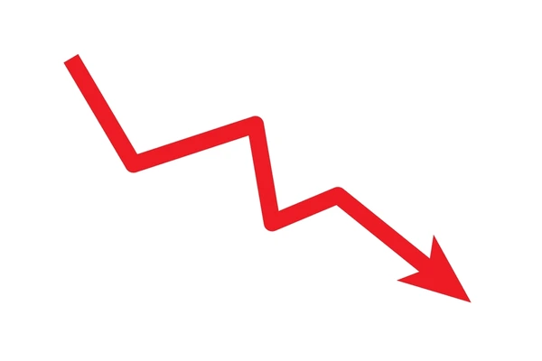


Key Findings: Impact of LEZ on Air Pollution
NO₂ Levels Decreased Inside LEZ
Significant drop in NO₂ at Townhead, High Street, and Kerbside Clear change after June 2023 (LEZ introduction) NO₂ remained high at Kerbside, but still improved
Limited or No Change in NO₂ Outside LEZ
Anderson and Great Western Road showed minimal change Confirms the impact of LEZ was localised
PM2.5 and PM10 Trends Show Slight Improvement
PM2.5 levels dropped moderately at Townhead and High Street PM10 showed smaller or inconsistent changes Pollution reduction is more visible for fine particles (PM2.5)
Pollution Was Highest in 2021–2022
Most stations peaked around 2021–early 2022 Seasonal spikes are seen in winter months

Slide 11


Conclusions:
The LEZ Policy Had a Positive Impact
After the introduction of the Low Emission Zone (June 2023), levels of NO₂ and PM2.5 decreased at monitoring stations inside the LEZ The reduction was not observed at stations outside the LEZ, it can especially be seen in Anderston station, highlighting the local effectiveness of the policy.
Pollution Levels Were Highest in 2021–2022
Time trend analysis showed seasonal peaks and higher pollution during earlier years, followed by a gradual improvement, especially post-LEZ
Pollutants Show Right-Skewed Distributions
Most daily readings were low, but occasional spikes occurred This pattern suggests pollution events linked to traffic or weather
PM2.5 and PM10 Are Strongly Correlated
These pollutants often rise and fall together, likely due to shared sources (e.g., dust, combustion) NO₂, however, behaves differently, reflecting its stronger link to vehicle emissions
Overall Conclusion:
The Glasgow LEZ is a promising intervention for improving air quality. While early results are encouraging, continued monitoring and expanding clean air strategies may further enhance public health benefits.

Slide 12
Future steps/improvements
Missing data: The Byres Road dataset has too much missing data, and should have been excluded. The Anderston dataset has a large gap which will cause problems with the conclusions. After looking at the other closest measuring stations, measurements from 2 of 4 might have been useful as substitutions, but time limits prevented these changes.
Covid: unusual measurements before about mid 2021 should not affect correlations, but could warp conclusions about whether pollution decreases over time. It was decided that this should be included, and the slider in the powerbi stage would allow the differences to be seen.leaving in the data could actually be quite interesting, but may need a longer time frame to be meaningful.
Additionally, some changes that would make the project more useful:
Including auto correlation - this would check the data for patterns over time
Checking the data more thoroughly for frequent small gaps, and for patterns in missing data
Standardising the axes of the graphs in python - this proved unexpectedly difficult, and was not included because of time constraints
Future steps:
From the graphs, it can be seen that pollution occasionally exceeded official limits. These events could be checked to see if there is a trend over time.
There are some notable peaks in PM pollution in mid 2023 and late 2024, which could be due to wildfires or weather events. Weather data and background pollution monitoring could be compared to see if there are correlations. Additionally, rainfall and wind speed could be checked to see if they correlate to the more ordinary fluctuations.
For one station, an increase was seen. The total pollution from all stations before and after could be be compared, to see if there is any change in overall pollution level.

